Slide 2
Migration Acceleration Program (MAP)
Notes:
MAP is a program that supports customer cloud adoption with a focus on AWS Migration Competency Partners to successfully execute migrations to the AWS Cloud
1. Incentives to offset the cost of migration in the form of credits to the end customer or cash to the AWS Migration Competency Partner in the Assess, Mobilize, and Migrate & Modernize phases.
2. Prescriptive guidance to execute migrations to the AWS Cloud based on hundreds of migrations to AWS.
3. Go-to-market and delivery enablement to support partners building an AWS migration practice.

Slide 3
Business drivers for migrating to the cloud
Agility and staff productivity
Outsourcing changes
EOL HW/SW
Improved security and operational resilience
Cost reduction
Data center consolidation
Going global quickly, M&A
Digital transformation
IoT and AI/ML
Notes:
There are many different drivers for customers like yourselves to initiate the journey to AWS.
They are driven by compelling events such as a cost objective, target dates to exit and consolidate data centers, or end of life hardware and software. But the conversation is changing.
Boards of Directors expect more than just cost savings and efficiency even though customers are achieving 25-50% savings in AWS vs. on premises costs.
They want to be able to move faster as businesses and transform customer experiences.
They want to deliver digital transformations and modernize their businesses.
They want to re-invest cost savings to drive new innovations and business models.
------------------------------------------

Slide 4
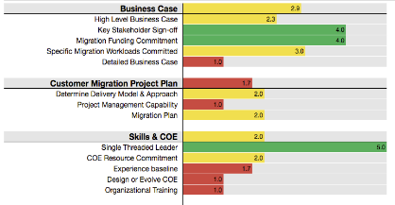


Customer Migration Journey
Assess
Mobilize
Migrate & Modernize
Migration Readiness Assessment (MRA)
Discovery and planning | Landing zone | Skills/center of excellence | Migration experience
Business case/ TSO Logic | Migration plan | Operating model | Security and compliance
Migrate
Business case
Rapid discovery
TCO report
Operate
Accelerators
Modernize
Briefings & workshops
Immersion day
Create a case for change
Mobilization through experiences
Accelerate migration at scale
Notes:
PRIMARY MESSAGE: MAP is built on a three-phase journey to systematically help you accomplish the migration journey. MAP starts with the Assess phase that includes a Migration Ready Assessment (MRA) along with a Rapid Discovery to support creation of a TCO model to help you build business support for your migration project. The second phase is Mobilize, which includes Mobilize projects designed to build your capabilities and experience, first-hand how easy it is to migrate to AWS. Mobilize includes eight work streams pictured here and the level of activity required in these work streams is determined by the readiness levels determined during the MRA. Mobilize activities include the actual migration of a recommended 2-3 applications, which is how your teams build migration capabilities alongside migration experts from AWS or partners. Mobilize typically runs from 2 to 6 months and involves ProServe and/or a partner that prepares you for large-scale migration and operation which is phase three. During Migration and Modernization, you will continue to migrate waves of applications, and operate and optimize your cloud environment and applications.

Slide 5
Migration Readiness
Current IT snapshot
Discover & organize data
Migration strategies for each workload (i.e. 7Rs)
Applications
Refactor
Asset inventories
App configuration data
Performance Information
Infrastructure
Re-platform
Repurchase
Level of effort
Performance
Rehost
CMDB
SLA/OLA
Architecture
Relocate
Retain
Retire
Tribal knowledge
Migration strategy decision criteria should be based on both business and technical needs
Notes:
Migration Planning
Understanding the details of the current environment, including where the data is, not just application data but operational data and how it is used and accessed, is critical.
AWS and our partners offer a collection of tools to help you make better decisions for architecture, modernization, and migration planning by discovering the current environment, dependencies, and identifying where there may be gaps in knowledge that need to be addressed to plan the migration.
AWS with partners help evaluate the 7Rs of migration and classify workloads for Refactor, Replatform, Repurchase, Rehost, Relocate, Retain, and Retire.
In the planning stage, we help customers move the first few applications into production while we plan to deliver the migration at scale.
------------------------------------------

Slide 6

Next Steps
Engage with key stakeholders in Business, Applications, Security & Infrastructure for Migration Readiness Assessment in a workshop
Evaluate tool-based assessment for application inventory and interdependency
Identify Migration Strategy for AIS workloads
Provide proposal to lay foundation for migration of this workloads to AWS
Notes:
ter

Slide 7
Appendix

Slide 8




Cloud Adoption
Migrations, Hybrid, Foundations
Application Modernization
Future-Proof with Containers & Serverless
Data Engineering & Analytics
Data Lake, Big Data Solutions
ELEVATE
Managed Cloud Operations
24/7 Cloud Support, DevOps, Continuity
Professional Services On-demand
Flexible, Cost-Effective Cloud Consultation
Cloud Cost Optimization
Cloud Spend Visibility & Control
OPERATE
AI & Machine Learning
Data Intelligence and Automation
Cloud Application Development
Build Cloud-Native Applications
IoT Devices
Hardware, Software, Analytics, Accelerators
INNOVATE
#thinkcloudnative
Notes:
With that, I’d like to briefly introduce you to the portfolio of offerings that Onica delivers. The Elevate category is all about adopting the cloud and improving your current infrastructure and processes with the cloud. The operate category focuses on helping you run production environments, and optimize and secure them. The innovate category is about building – new capabilities, new innovation, and new technology that can propel your business forward.

Slide 9
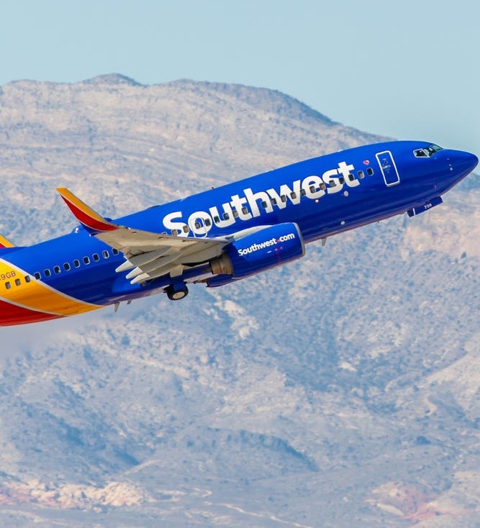




c
Rackspace modernized 40 mission critical applications for Southwest
Problem:
Needed to migrate Tier 1 “required to fly” system of 40 applications from on-prem to AWS with zero downtime
Solution:
All 40 applications were containerized and pipelined into AWS using 18 cloud-native services
Results:
Quicker production releases
Hours-long deployments now take seconds
Automated failover: 1-click deployment, less than 20 minutes of downtime
Irregular Operations and unplanned failures went down 40%
Nobody knew the cutover even occurred!
Rackspace is the only outside party sitting on Southwest’s internal architecture committee
9
Privileged and Confidential

Slide 10
Our Understanding of Needs of CCC
Auto Injury Solutions is a national medical and automobile insurance company and is currently part of CCC Information Services
AIS has 410 VM’s workloads deployed in Rackspace private cloud in DFW and 76 VM workloads as Disaster Recovery environment in Chicago.
Migration to AWS will achieve desired goal of Cost Savings and unlock potential to innovate with applications and data.
Notes:
ter

